Slide 1

Palliative and Hospice Care
Evaluating the Quality and Cost of Care in the U.S.
Discussion Document
Casey King Valerie Meausoone Vineetha Nalini Elena Petrov August 2019

Slide 2


Background
The U.S. economy and social fabric will be transformed by its rapidly aging population
The aging population will place significant stress on our healthcare system, particularly as it relates to end-of-life care (or EoLC)
EoLC comprises two critical health care services:
1) Palliative care
2) Hospice care
Two separate government administered healthcare programs influence the delivery and cost of services

Slide 3
Research Questions
Our objective is to understand the quality, utilization and cost of palliative and hospice service in the U.S.
Key Research Questions
How extensive are palliative and hospice care services in the United States?
How are these services distributed across states?
What are the (1) quality, (2) utilization and (3) cost characteristics of palliative and hospice care services delivered in the U.S.? Is there significant geographic variation?
How do patient satisfaction levels differ between wealthy and poor regions?
Hypothesis
Given that palliative services are only partially covered by health care programs in the U.S., we expect that (1) income levels will directly impact the quality and cost metrics, and (2) the demand, quality and cost structure will vary at the state/county level.

Slide 4
Data Preparation
Several disparate data sets were identified from publicly available data
Aggregation of the data entailed significant data wrangling
Quality of Care Data Sets
Hospice Compare Data
State-by-State Income Data
Most Economically Disadvantaged City Data
Palliative Care ‘Report Card’ Data
Medicare Data Sets
Medicare Data Entrepreneurs’ Synthetic Public Use Files
Inpatient datasets: 10 files
Outpatient datasets: 10 files
Carrier files: 20 files (split in 2 due to large size)
Beneficiary files: 30 files (10 for 2008, 10 for 2009 and 10 for 2010)
U.S Census, Population, Income and Crosswalk/Mapping Data Sets
Zip Code Characteristics
FIPS / ZIP Crosswalk
Medicare Beneficiary Summary File
SSA State Code / State Abbreviation / State Name Mapping
SSA / FIPS State County Crosswalk: 2011 County Crosswalk

Slide 5
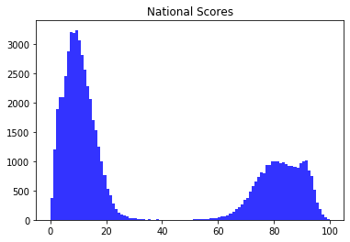
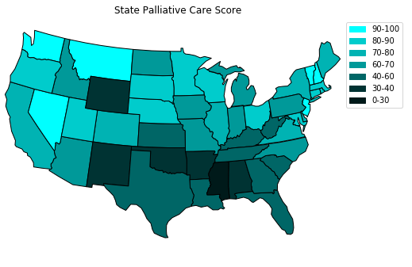
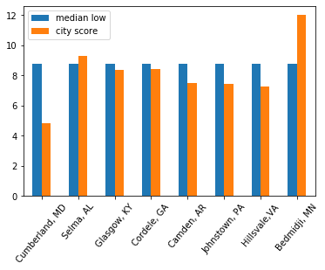
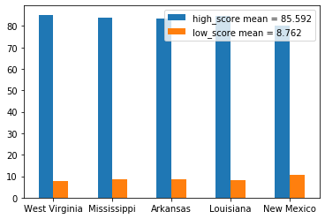
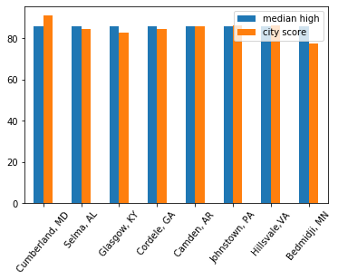
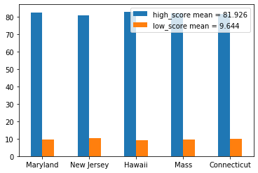
Analysis of Quality of Care
Hospice Care Quality monitoring is Federally Mandated
Despite that fact, the data suggests that there is little variation between states
This is a profound contrast to palliative care measurements
This suggests that the measurement tools are inadequate to the task

Slide 6
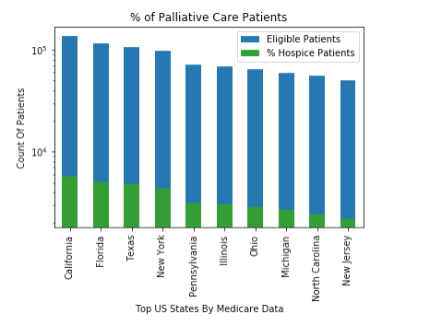
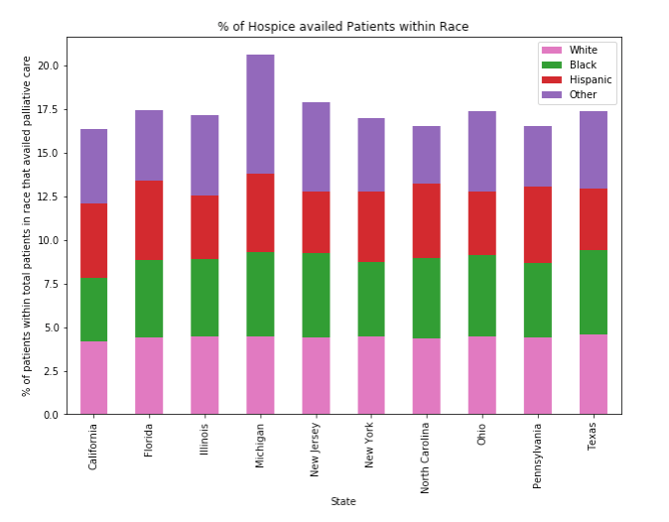
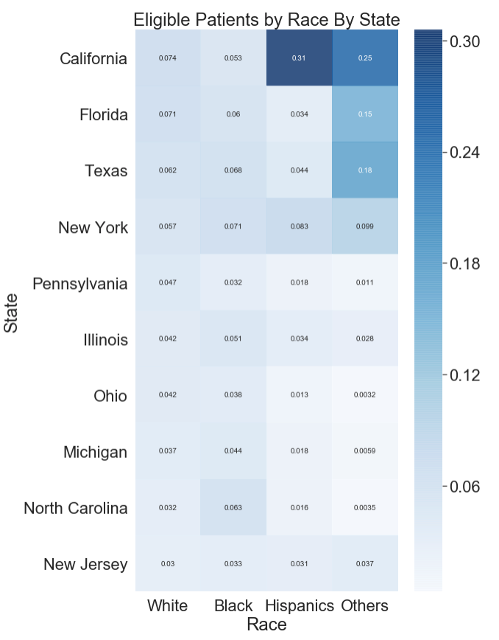
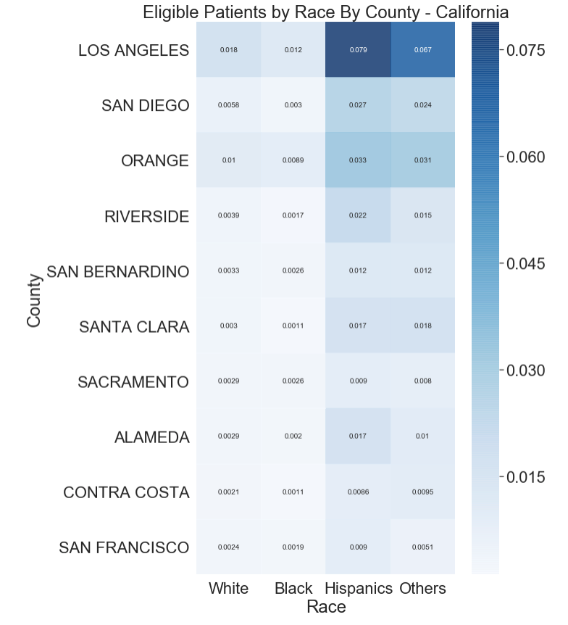
Analysis of Services
Synthetic Data confirmed that palliative care is administered more or less uniformly across states, in terms of utilization
In terms of the percentage of palliative demographics, some states had more hispanic and others than whites
It is hard to know if there are granular differences, since these synthetic data are quite coarse
* Top US States are defined as the States with the most number of Palliative Eligible Patients

Slide 7
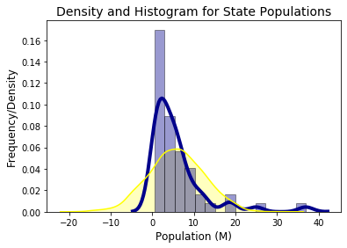
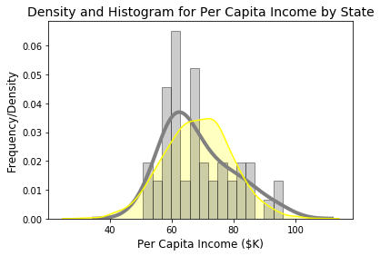
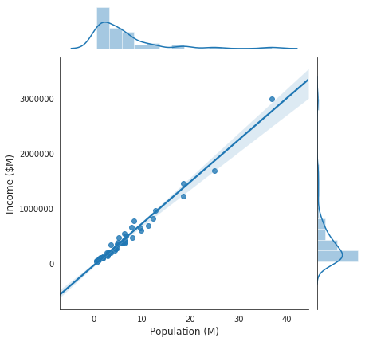
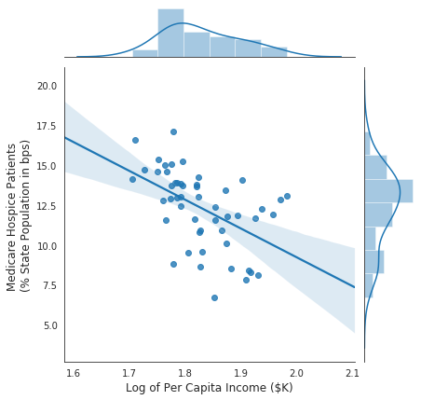
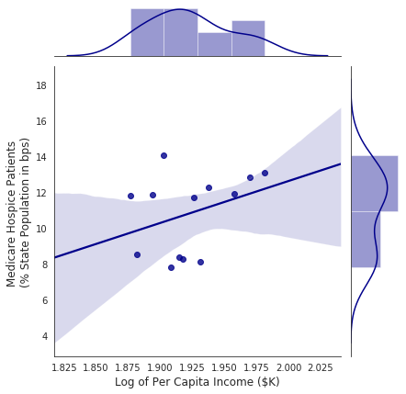
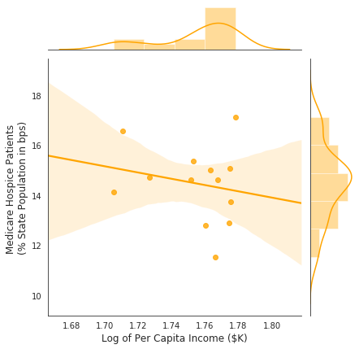
Analysis of Hospice Service Rates and Income
Joint Distribution Between State Income and Population
Joint Distribution Between Medicare Hospice Patients as % of Population and Log of Per Capital Income
Significant clustering and heteroskedasticity were observed when joint distributions between per capita rate of Medicare hospice services and the log of per capita income
Top Quartile States by Log of Per Capita Income
Bottom Quartile States by Log of Per Capita Income

Slide 8
Conclusion
Our findings suggest the data quality of the primary source files is questionable
We expected to find geographical, socioeconomic and racial differences in Palliative Care
Hospice score and synthetic data did not show any geographical, socioeconomic differences in Palliative Care. As a result, the overlay with Census data proved to be somewhat inconclusive
Medicare data did not show any racial disparities in Palliative Care
Based on these findings, we believe that the data quality is questionable
We believe this suggests further analyses with real Medicare datasets

Slide 9
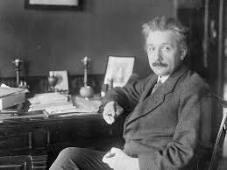
Q&A
“Information is not knowledge.” —Albert Einstein

